Slide 1
Project Delivery
FTI DIALOGUES| 03.19.2021

Slide 2
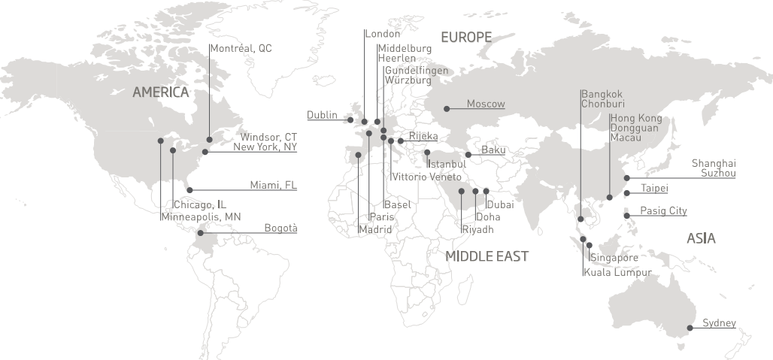
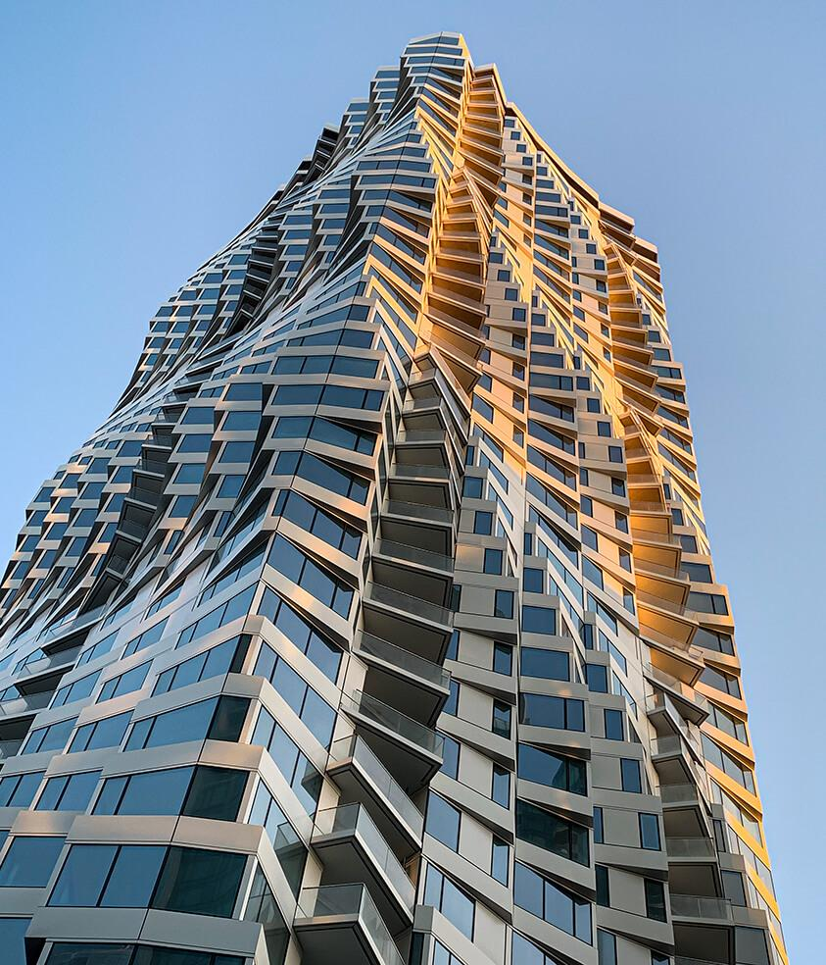
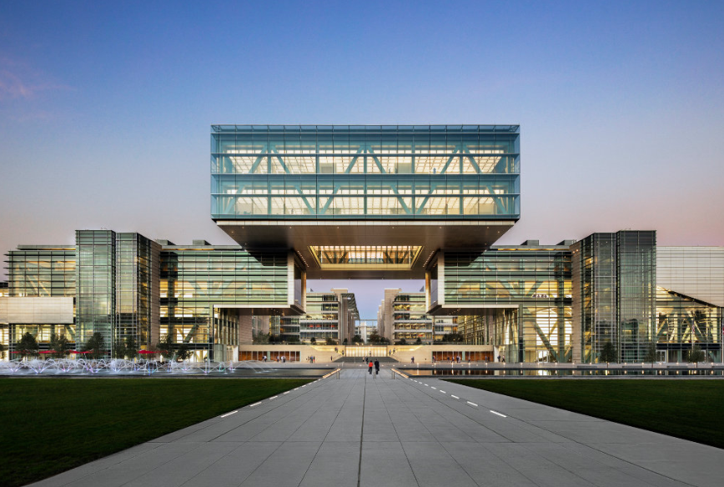
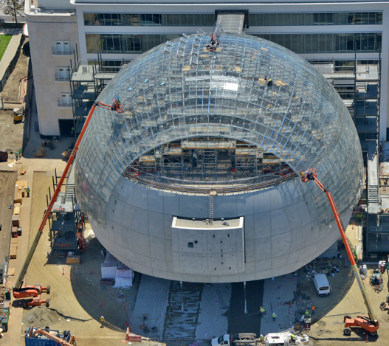
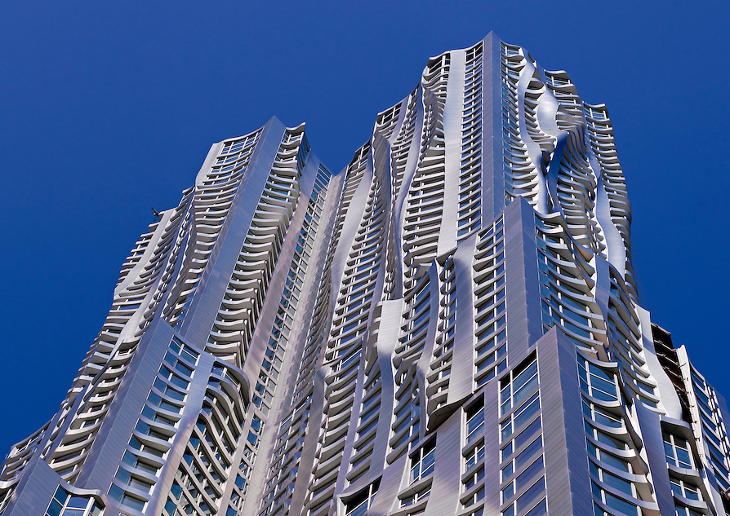
The PERMASTEELISA GROUP
A TRANSNATIONAL GLOBAL ENTERPRISE
+/- 1,100 engineers & designers
17 design offices
9 manufacturing plants
Permasteelisa + Gartner brands

Slide 3
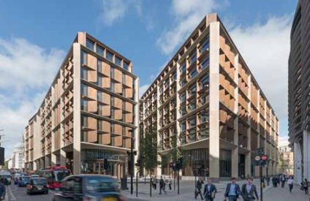
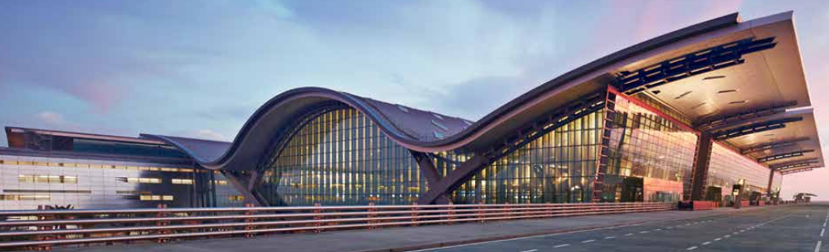
STATE of the MARKET
Innovation
Schedule
The result: GAPS
Responsibility
Schedule
Expectations
Project Delivery
Budget
Notes:
Innovation: Daylighting, Ventilation, Comfort, Thermal Performance, New Materials
Schedule: City requirements, Very quick ‘go’ periods
Budget: Rising price of materials, global supply chains, rising price of labor

Slide 4
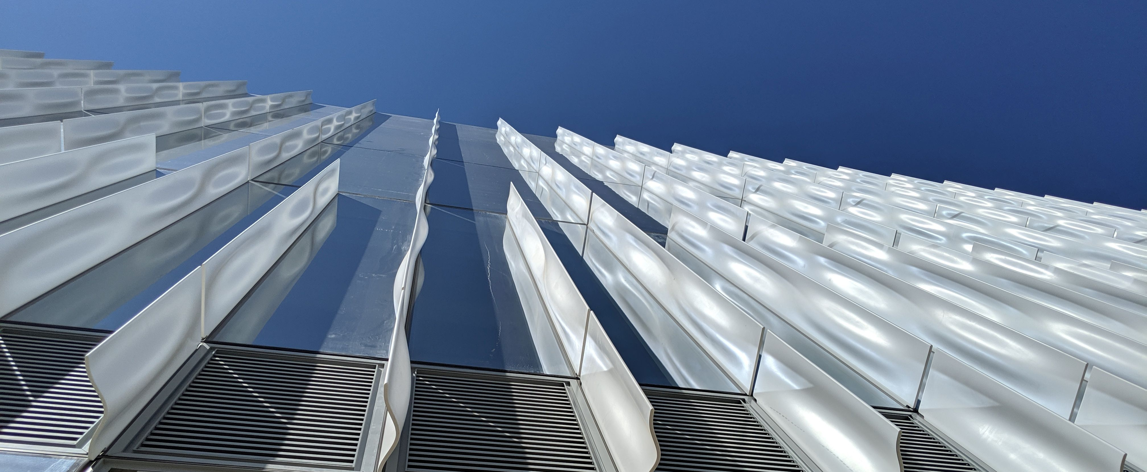
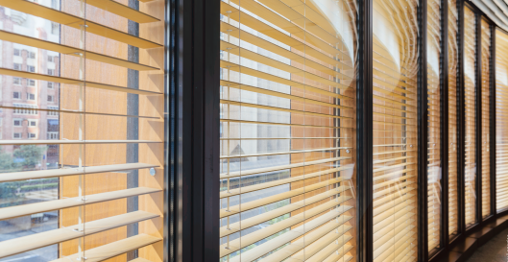
DECONSTRUCTING the INNOVATION CHALLENGE
Conceptual
Technical
Operational
Concept Des.
100% SD
100% DD
~50% CD’s
Budget validation
Design intent
Major non-starter
Performance
Life-cycle exp.
Sch. Design works
Supply Chain
Validated pricing
Stakeholder risks & expectations
Notes:
Conceptual: Is there ‘something there’?
Technical: Upon closer study. the concept continues to work in principle
Operational: Lead times, vetted pricing pose no threats. All stakeholders understand and agree on any risks & expectations

Slide 5
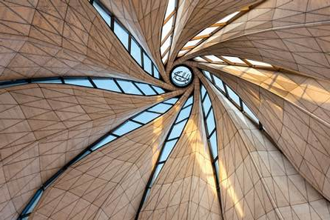

NAVIGATING the INNOVATION PROCESS
What’s working
Up-front goal setting; what result would make this a successful process?
Roles & Responsibilities within the project team
Duties can change from phase to phase
Design-assist v. Design-build v. delegated design, etc.
Document the process
Understand as a team when the phases change
Know when to shift gears
Notes:
Roles & Responsibilities: Design-assist / Design-build can turn into Build-Design.

Slide 6

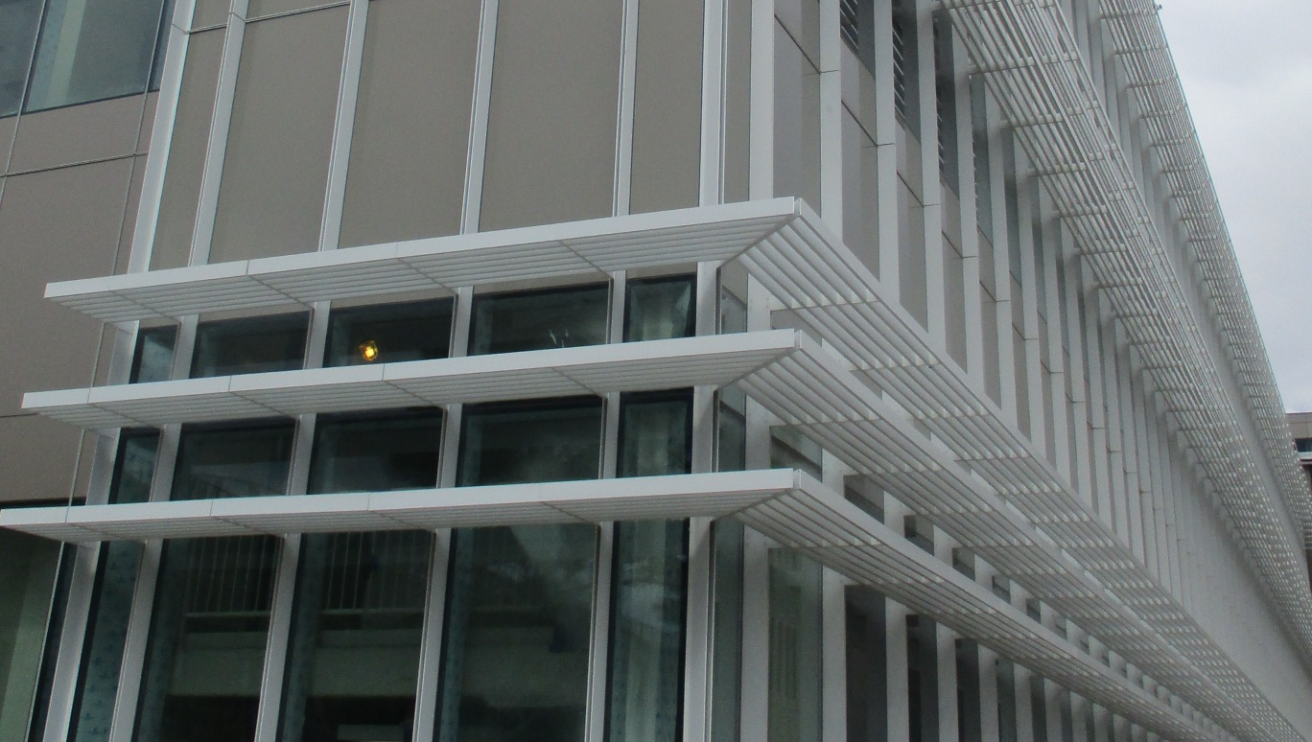
PROCESS EXAMPLES – Innovative Collaborations
Deep collaborations at intersectional points in the façade design process:
Thermal performance
Daylighting / Shading
New materials / New material usages

Slide 7
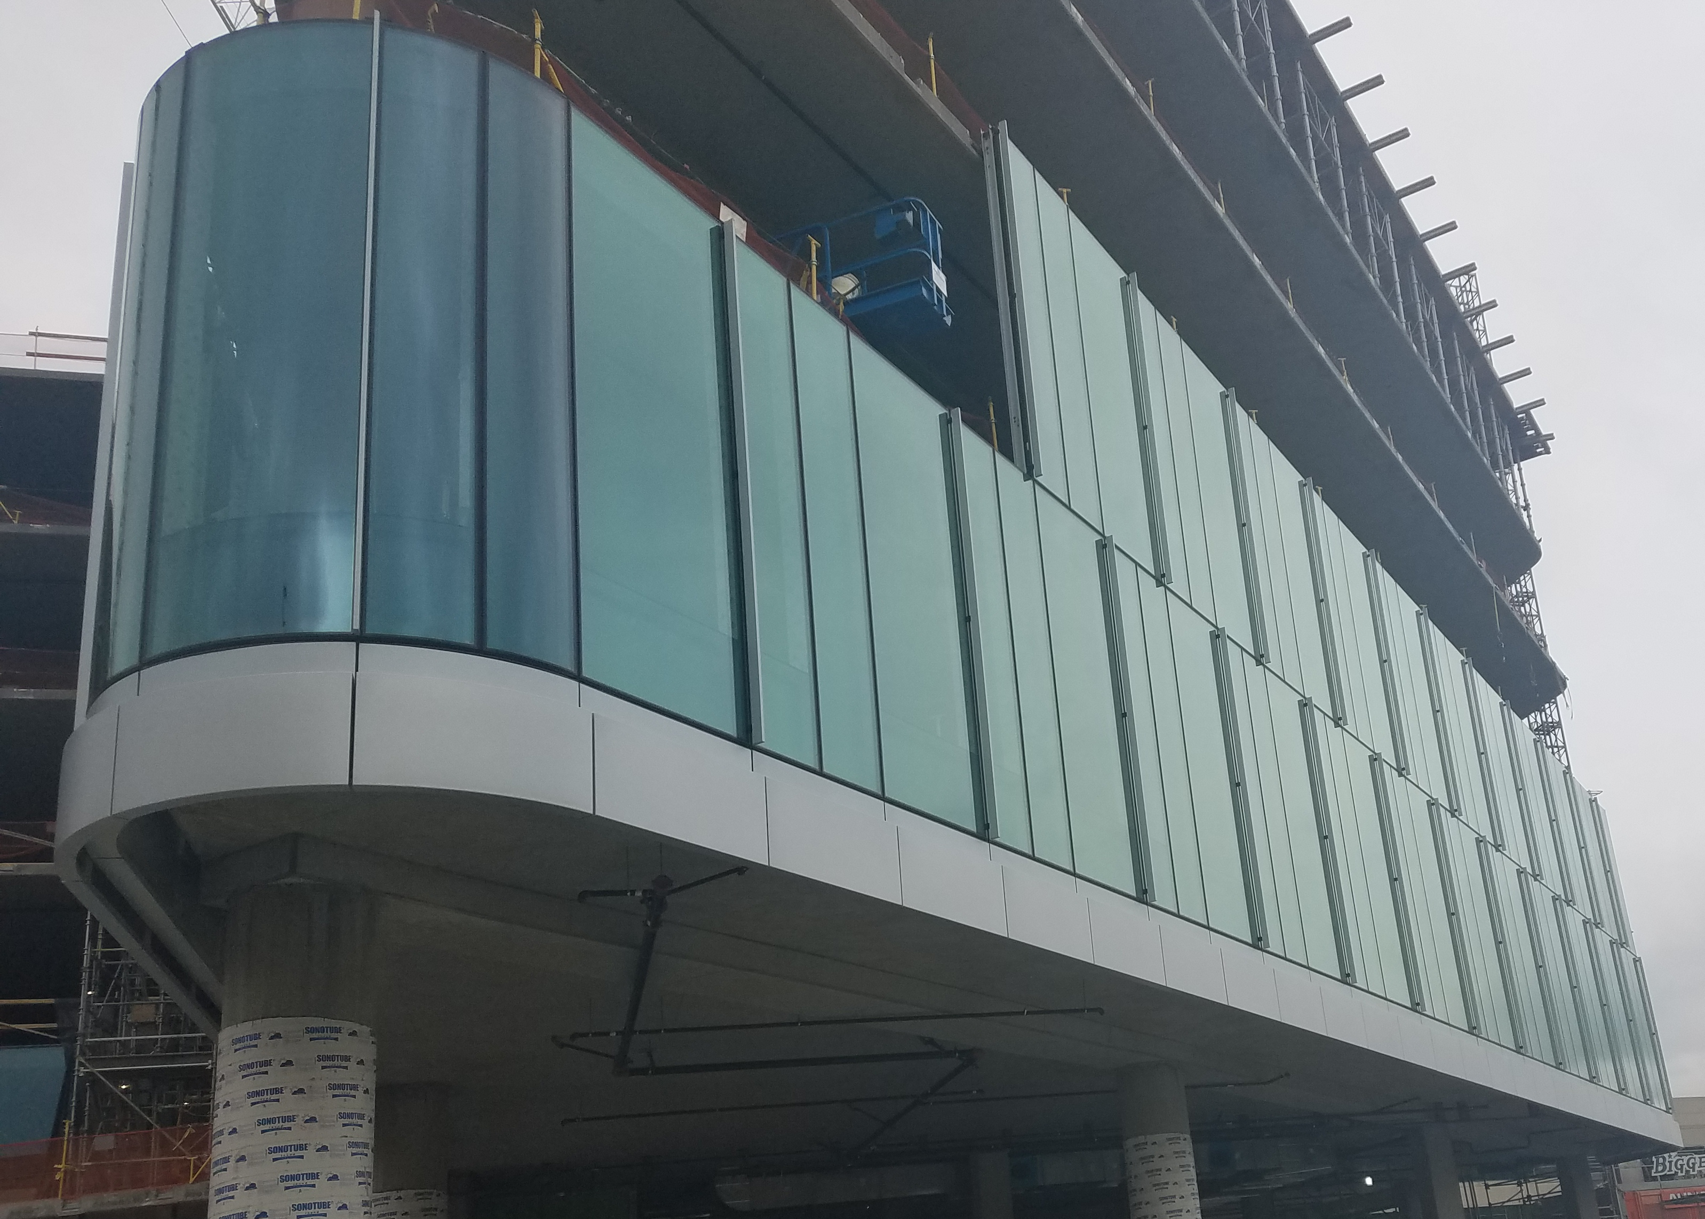
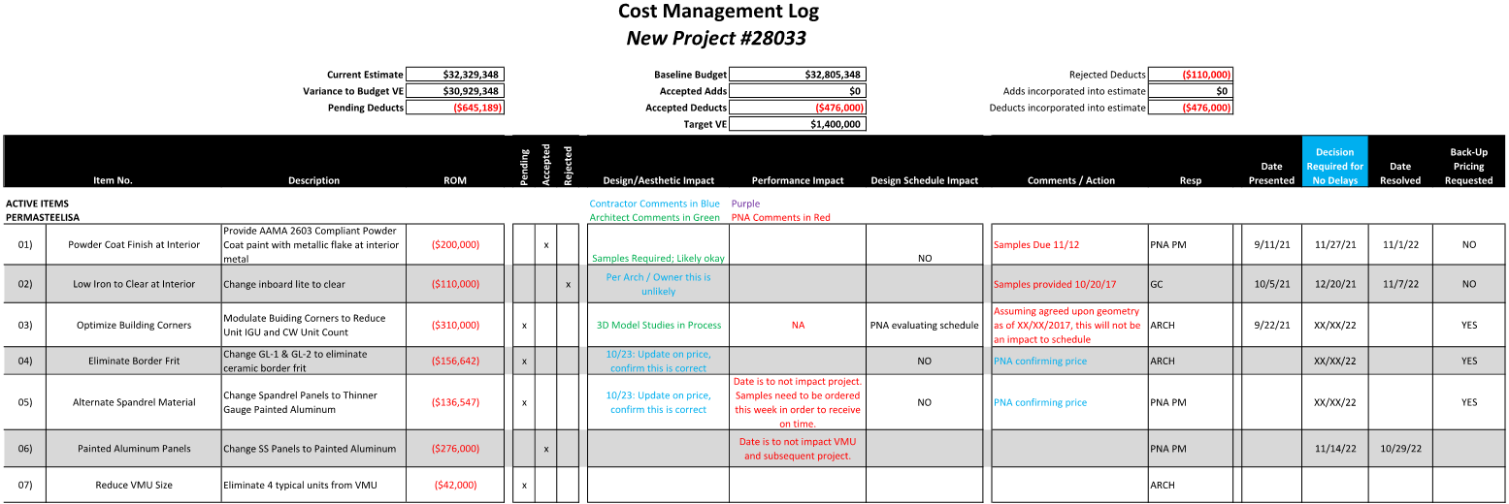
PROCESS EXAMPLES – Target Value Design
Collaborative give/take working towards a fixed target
Establish baseline quantities, prices, and assumptions
Multi-disciplinary involvement
Ideas / open cost items & overall progress are openly tracked

Slide 8
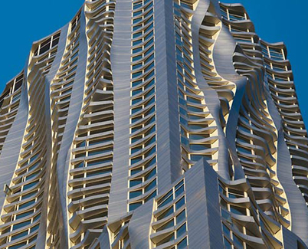
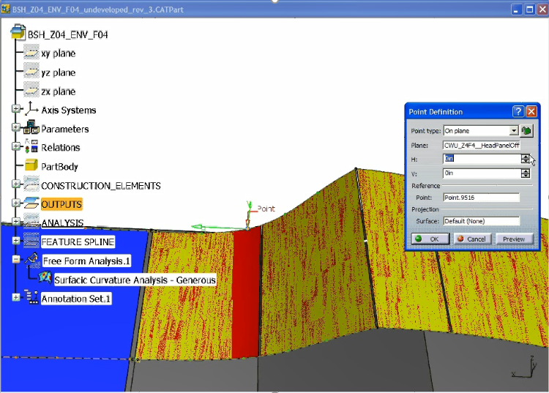
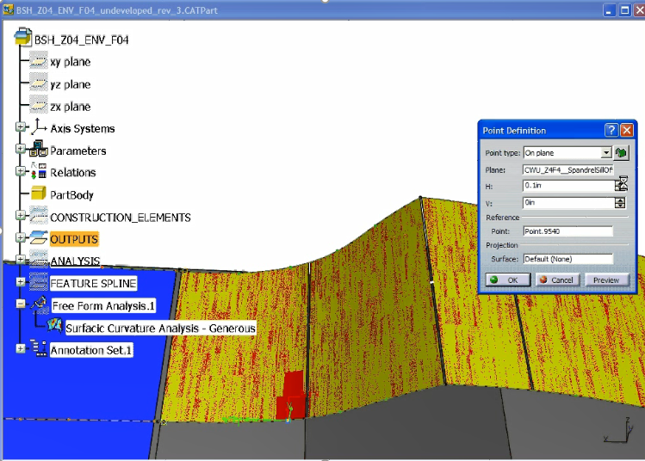
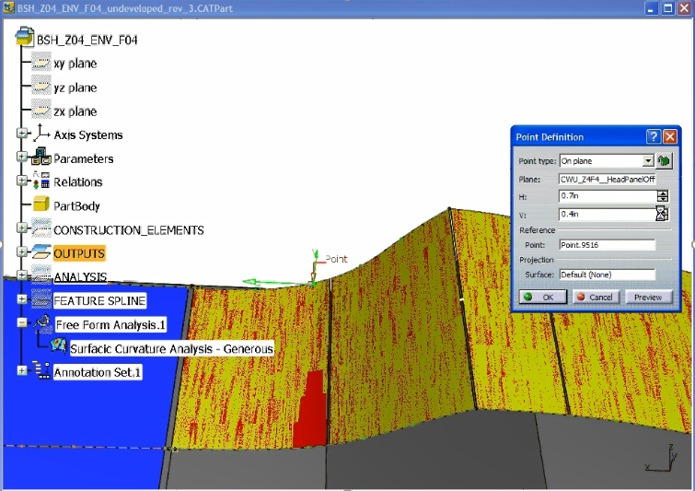
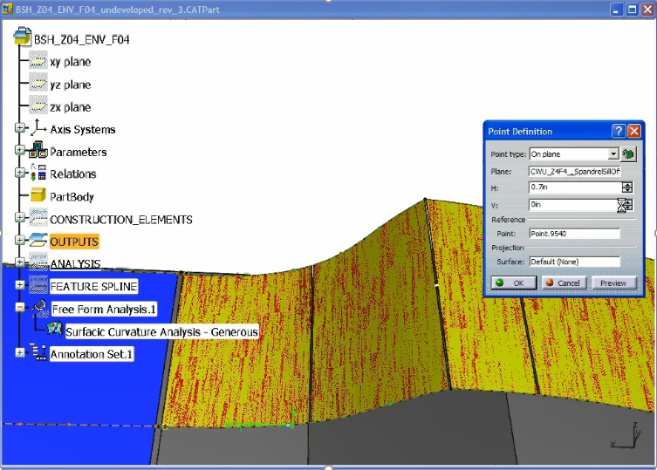
PROCESS EXAMPLES – Design guardrails
Establish boundaries / rules for key elements
Material limitations
Key points of escalation
Iterative design & cost validation

Slide 9

